Slide 1


CARBON FOOTRING IN GREEN COMPUTING
GROUP NO - 9

Slide 2
GROUP MEMBERS
SAMI VORA (100) DHARABEN PATEL (141)
GUNJA SINGH (88) BHAVESH KUMHAR (126)
MANAV SHETTY (84) RUPAL PATEL (59)
DAKSH RAI (123) NIYATI SHAH (77)

Slide 3

HISTORY
Started in 90’s
Energy star program
Basic use
Goal

Slide 4

INTRODUCTION
GREEN COMPUTING
Environmentally responsible
Disposal of electronic waste (e-waste)
Reducing environmental hazardous material
sustainable resources
Green computing technology
stages in the lifecycle

Slide 5
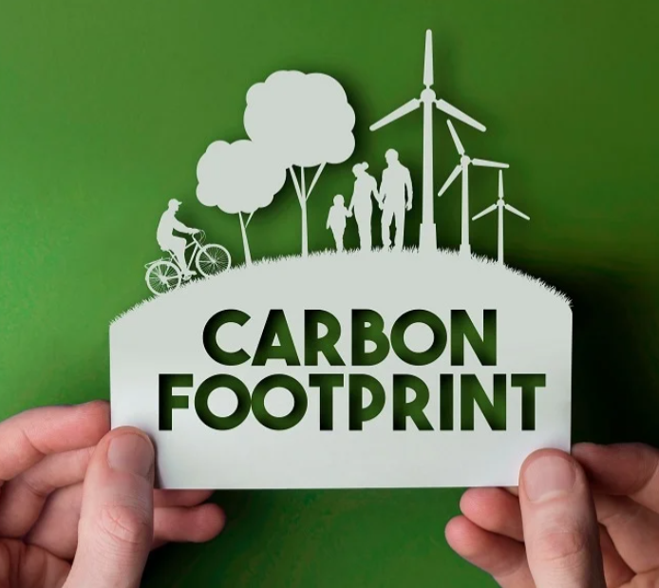
CARBON FOOTPRINTING
Greenhouse Gases (GHG)
Global Warming
word's carbon dioxide emission percentage
important measure
Human Activities

Slide 6

TYPES OF GREEN COMPUTING
Solar Power System
Wind Turbine Program
Geothermal Power

Slide 7

GOALS OF GREEN COMPUTING
To minimize the implementation of hazardous products.
More production of energy efficiency.
To use the recyclability of wasted product and factory wasted products.
To design proper algorithms for improve the computer’s efficiency

Slide 8

NEED OF GREEN COMPUTING
1)Save energy
2)Save environment
3)Recycle of wate product
4) Save Money
5)Energy consumption

Slide 9

APPROACHES TO GREEN COMPUTING
Terminal Servers
Power Management
Power Supply
Storage
Product Recycling

Slide 10
ADVANTAGES
1) Energy Saving
2) cost saving
3) Recycling Process
4) Brand Strengthen
5) Less pollution
6) GHG Emissions
7) chemical exposure
8) Green IT implementation
9) Saving energy and resources saves money
10) Renewable energy

Slide 11
DISADVANTAGES
1) Implementation cost
2) Performance
3) Maintenance
4) Adaptation
5) Security leaks
6) IT knowledge
7) Support system
8) Green IT cause more burden to an individual
9) Rapid technology Change
10) Power Management

Slide 12

EXAMPLE
E.g.- Renewable Energy Sources:-
Renewable energy sources don’t use fossil fuel. They are available freely, are environmentally friendly and generate less pollution. Apple, who is building a new corporate centre, is planning to use most of the building’s wind turbine technology, and Google has already built a wind-powered data centre.

Slide 13

METHODS TO CURE CARBON FOOTPRINTING IN GREEN COMPUTING
Improving systems' efficiency
Old PC's
Outdated part and insufficient memory
Upgrade the equipment
Using Renewable Energy in IT
Green computing Eco-friendly
Carbon free computing
Solar energy computing

Slide 14

FIVE WAYS TO REDUCE CARBON FOOTPRINT
learn the 5 R's: refuse, reduce, reuse, rot, recycle: Going zero waste is a great step towards combating climate change. ...
bike more and drive less: ...
conserve water and protect our waterways: ...
eat seasonally, locally, and more plants: ...
switch to sustainable, clean energy:

Slide 15
HOW YOU CAN SUPPORT GREEN COMPUTING
Energy star labeled products
Turn off computer
Optimal brightness level
Use of IT peripherals
Screen Saver
Environmental Companies
Donate or Recycle
Both side printing

Slide 16

Sleep mode
Power Management
Use email
Non-petroleum inks
Use VoIP technology
Replace LCD/CRT to OLED
Participate recycling program
Green packing solution
Don’t buy new printers

Slide 17

HOW WE CAN CALCULATE CARBON FOOTPRINT
Define what all thing contributes to the carbon footprint
Baseline should be set
Track and analyse the carbon footprint of the organization
Report the result to stakeholders

Slide 18

CONCLUSION
Features of Green computing
Society needs more consumption
Alternative ways to design system
Contribution to green computing
Eco-friendly sustainable component

Slide 19

THANK YOU

